Slide 1

DETECTION OF DEGREE OF STRESS USING MACINE LEARNING
Guided by - Mr Sravan Kumar
Done by –
CH Nehanth Reddy -18071A12D4
G Siva Sai Teja -18071A12E0
P Bharath -18071A12G0
P Shiva Prasad-18071A12G1

Slide 2
ABSTRACT
Every year tens of millions of people suffer from depression and few of them get proper treatment on time and some of them are not. This depression is the result of heavy stress .Every nine out of ten are suffering with stress because of work-overload ,family problems etc.. So, it is necessary to know whether the person is stressed if then he/she should be treated before stepping into danger situation which leads to problems like Heart Stoke, Depression etc

Slide 3
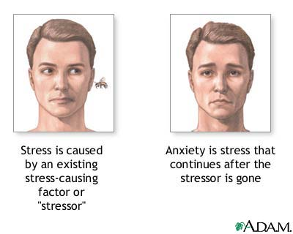
WHAT IS STRESS?
Stress is a feeling of emotional or physical tension. It can come from any event or thought that makes you feel frustrated, angry, or nervous. Stress is your body's reaction to a challenge or demand. In short bursts, stress can be positive, such as when it helps you avoid danger or meet a deadline.

Slide 4
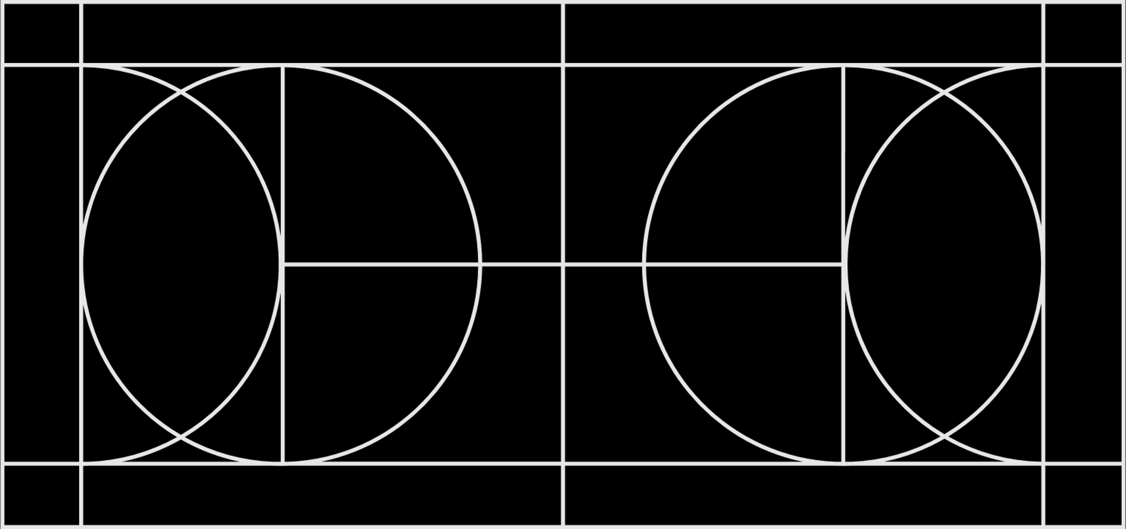
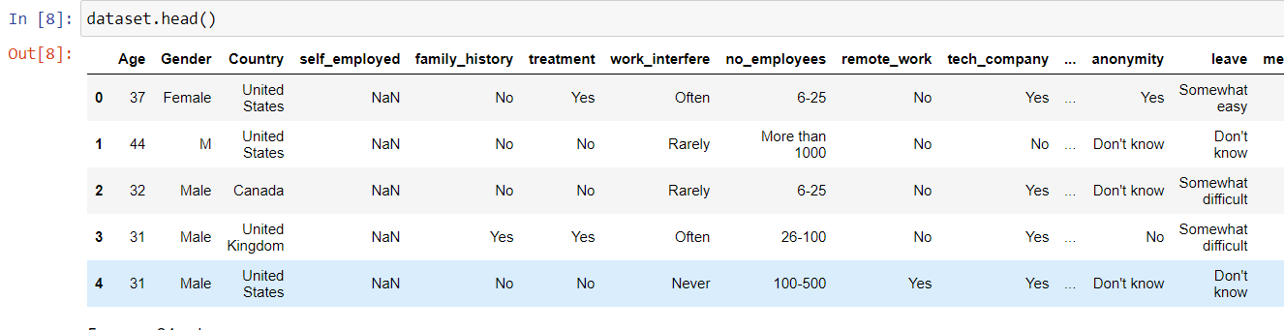
OUR DATASET
NOTE:SINCE OUR DATASET IS HUGE WE ARE ATTACHING THE HEAD OF THE DATASET

Slide 5

ALGORITHM USED:
NAÏVE BAYES

Slide 6
WE HAVE USED VARIOUS DATA VISUALIZATION TECHNIQUES AND THEY ARE:-
Matplotlib: low level, provides lots of freedom.
Pandas Visualization: easy to use interface, built on Matplotlib.
Seaborn: high-level interface, great default styles.

Slide 8

OUR USER INTERFACE:

Slide 9
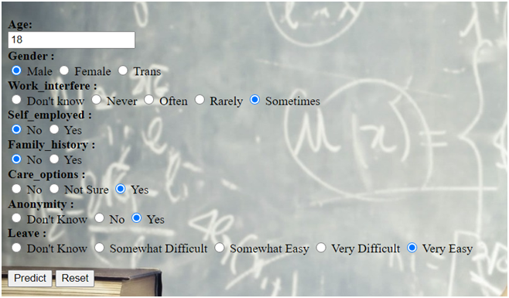

SOME USER INPUTS AND ITS PREDICTION
1)

Slide 10
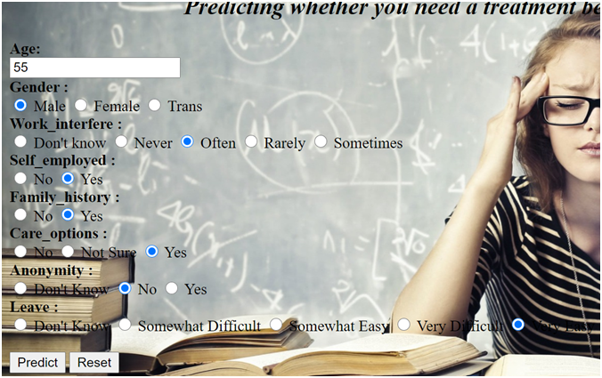

2)

Slide 11
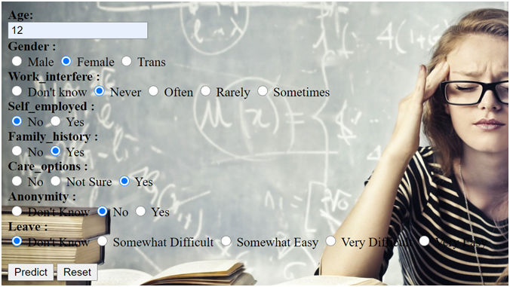

3)

Slide 12
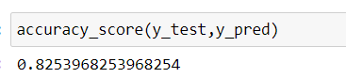
MODEL EVALUATION:
WE HAVE GOT A GOOD ACCURACY

